Slide 1


IBM SkillsBuild
Data Analytics Internship Programme

Slide 2
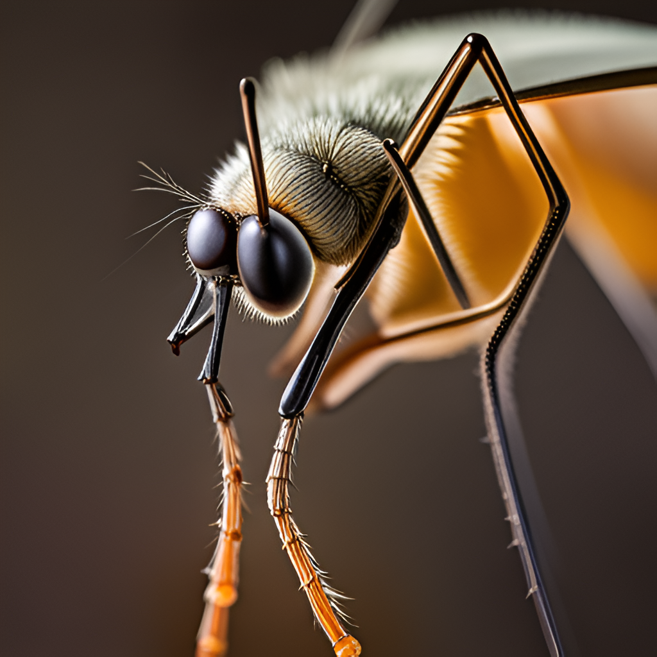
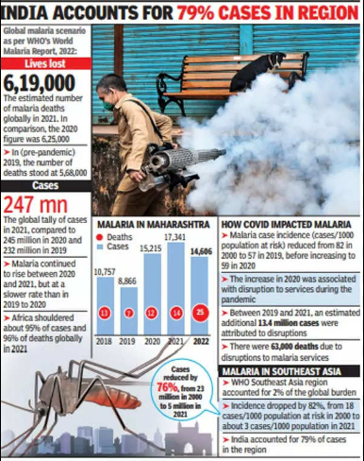
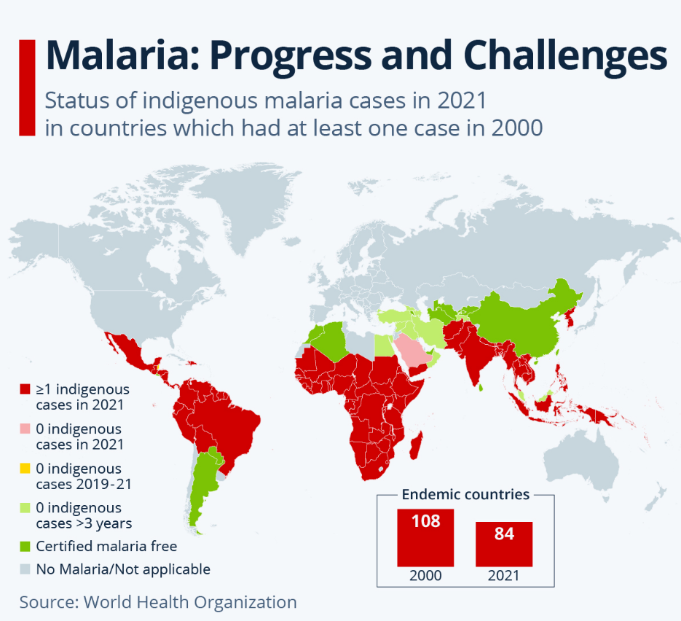
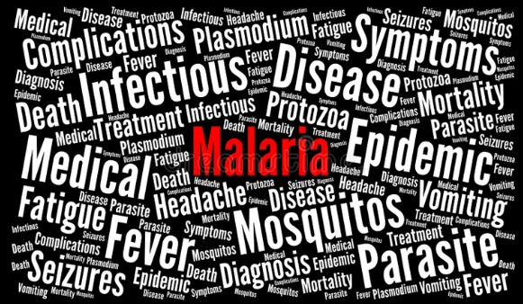
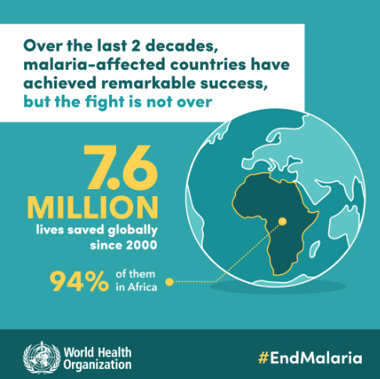
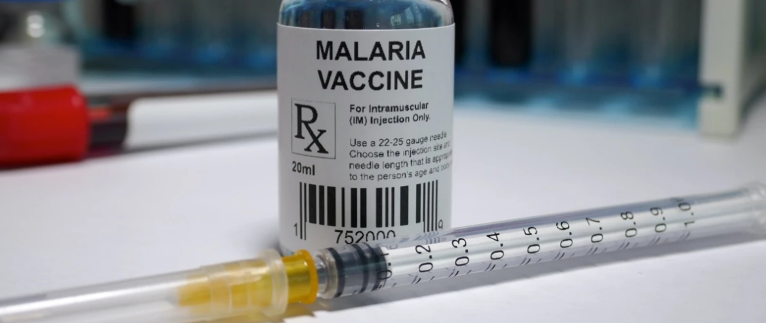

MALARIA DETECTION AND DATA ANALYSIS
AJ Tech
PRESENTED BY TEAM NUMBER 49

Slide 3

TEAM MEMBERS
NAMES
EMAIL-ID
Aakash Chari
Aniket Pandey
Jishnu Nair
Jalaluddin Ansari
Shivani Singh
chariaakash08@gmail.com
aniketpandey162003@gmail.com
jnair256@gmail.com
ajtechno01@gmail.com
shivanisingh07080708@gmail.com
GAUHAR ADEEL GHAZI

Slide 4

INTRODUCTION
Malaria is a disease that has plagued humanity for centuries, causing millions of deaths and untold suffering. It is caused by a parasite that is transmitted through the bites of infected mosquitoes, and it affects people in tropical and subtropical regions around the world.
Despite efforts to control and eradicate the disease, malaria remains a major public health challenge, particularly in developing countries where resources are limited. In addition to its human toll, malaria also has significant economic impacts. The disease can cause lost productivity due to illness and death, as well as increased healthcare costs and decreased tourism in affected areas. As such, finding effective ways to detect and treat malaria is crucial for both individual and global health.

Slide 5

PROJECT SUMMARY
As we all know that Malaria is a serious disease that spreads when you’re bitten by a mosquito infected by tiny parasites. When it bites, the mosquito injects malaria parasites into your bloodstream.
However, it can be diagnosed if a proper medication is given to the patient on right time to protect them from this dangerous. That is why it is important to detect the disease as early as possible for prevention.
Our project focuses on detecting the cells causing malaria. We have used some python libraries for data preprocessing like Numpy and Pandas for Data Visualization Matplotlib and Seaborn
and for Training the model we have used Tensorflow and Scikit-learn based on Convolutional Neural Network (CNN) one of the type of Machine Learning.
Monkeypox is an infectious viral disease that can occur in humans and a few other animals. Monkeypox virus, scientifically called zoonotic viruses in the genus Orthopoxvirus, is the cause of the disease. It may spread from infected animals by handling infected meat or via bites or scratches.
Human-to-human transmission can occur through exposure to infected body fluids, contaminated objects, contaminated tiny droplets, and possibly the airborne route. The first confirmed case was traced to an individual with travel links to Nigeria (where the disease is endemic) and was detected on May 6, 2022. Although, the cases were already spreading in the previous months, according to suggestions. From 18 May onwards, cases were reported from an increasing number `of countries and regions, predominantly in Europe but also in North and South America, Asia, Africa, and Australia.
The World Health Organization has declared this an "Evolving Health Threat" rather than a Public Health Emergency of International Concern.

Slide 6



PURPOSE OF THE PROJECT
The project aims to illustrate MALARIA causing cells our dataset provide image of infected cells and uninfected cells.
Data Preprocessing had been done to convert images to a numpy array and keep and remove essential datas.
Focus on Malaria disease analysis at the global level.
The goal is to provide a model which can detect whether a cell is Parasitized by Malaria or not.

Slide 7

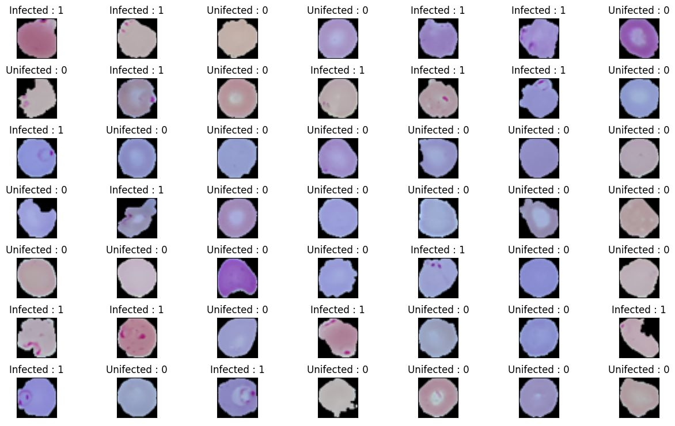
SOURCES OF DATA USED
The dataset used in this project is taken from Kaggle. There are several attributes in the data set on which we are predicting, analyzing, visualizing, and detection of malaria through image.
Dataset for contributing factor:
https://www.kaggle.com/datasets/iarunava/cell-images-for-detecting-malaria

Slide 8
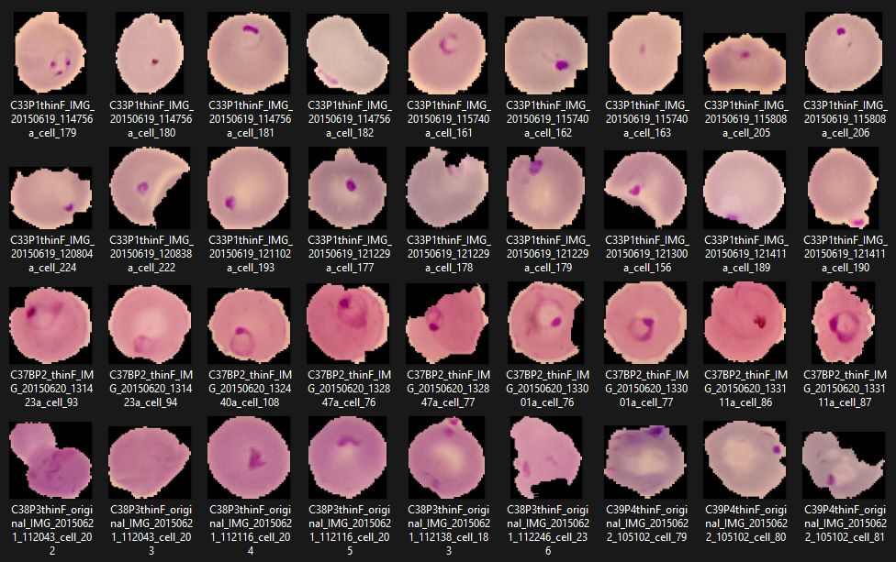
https://www.kaggle.com/datasets/iarunava/cell-images-for-detecting-malaria

Slide 9
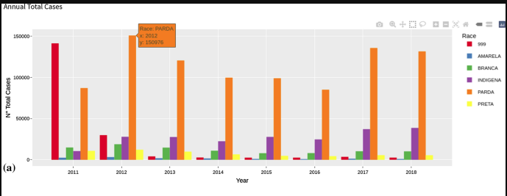
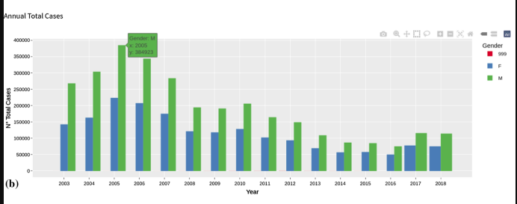
DATA VISUALISATION OF CHARTS AND GRAPHS
Here we are showing some Exploratory Data Analysis (EDA) from three data sets which we have used to show in bar graph.
The first graph shows the race of the mosquito through which people have been infected.
The second graph shows the gender of the infected ones.

Slide 10
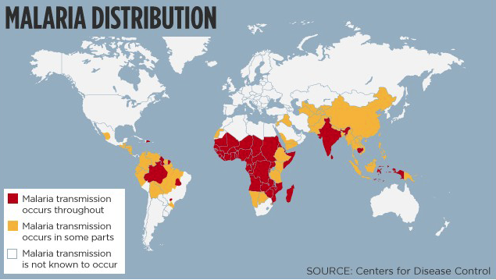
MALARIA AROUND THE WORLD
With this, we are showing malaria around the globe with the help of a measuring scale (the dark side of which is showing the highest number of confirmed cases and the light side of the scale is showing a lower number of cases).

Slide 11
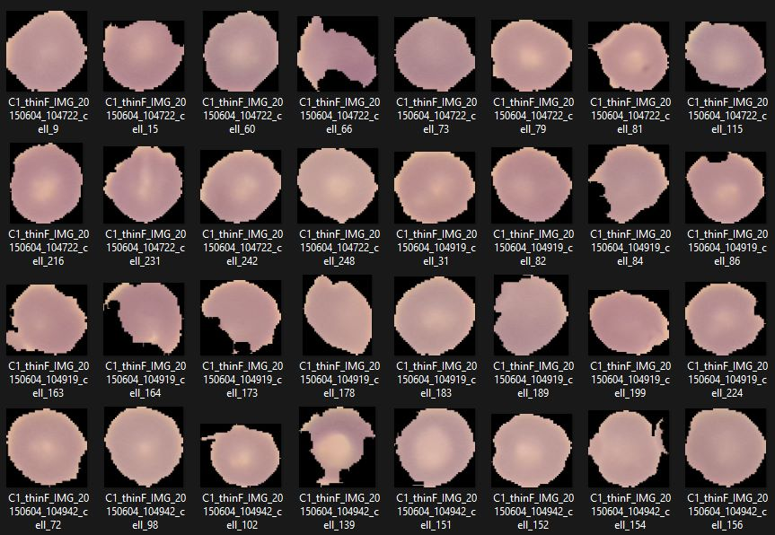
Here we are showing two data sets in that we are detecting and predicting whether a person is having malaria or not.

Slide 12
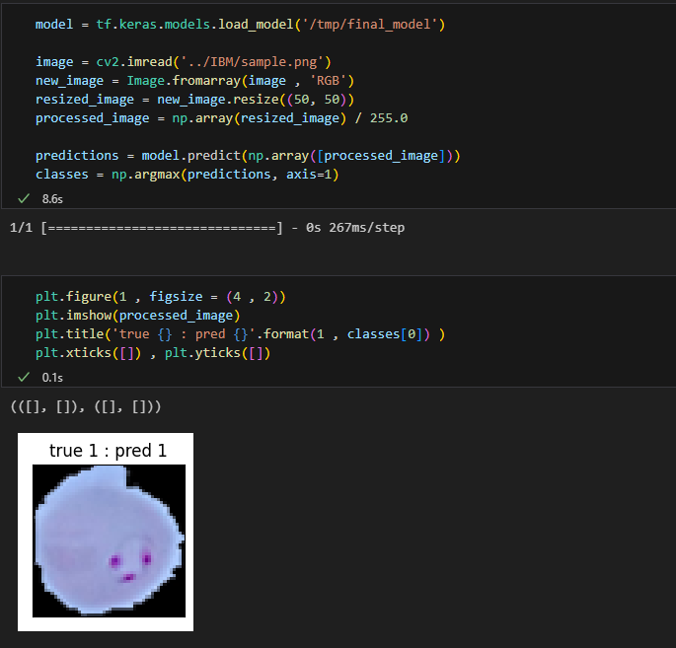
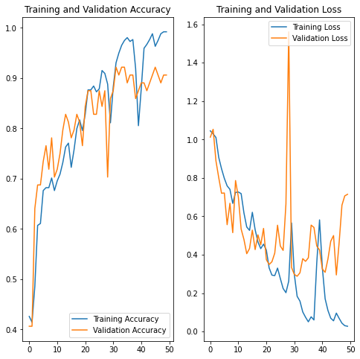
Here we have taken one picture from datasets to predict whether the cell is parasitized or not.
In that prediction, we had 90 to 95 percent accuracy in detecting malaria.

Slide 13
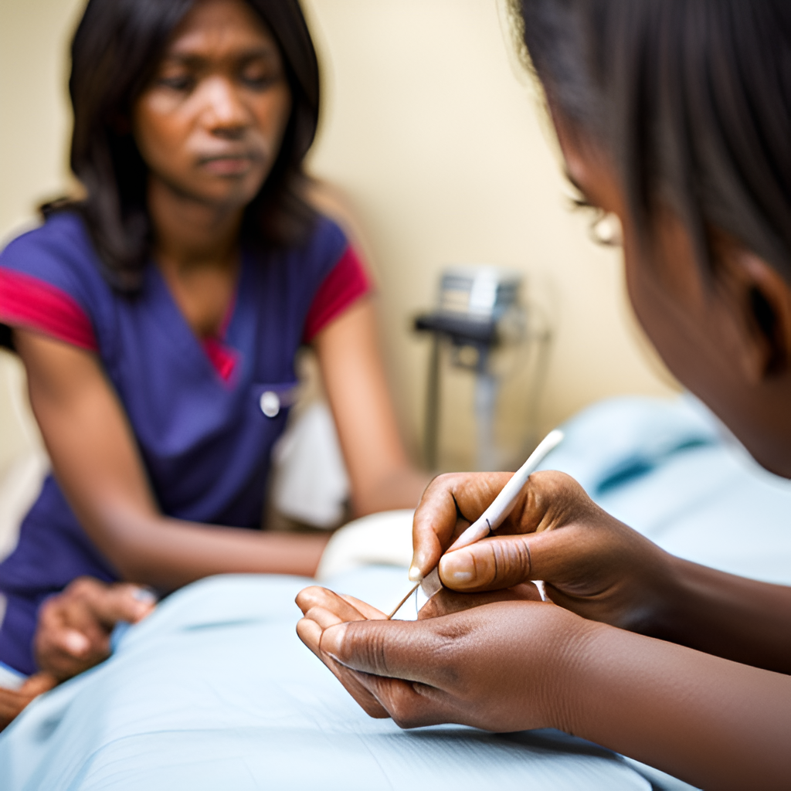
CONCLUSION
In conclusion, we have discussed the challenges of detecting malaria and the promise of using convolutional neural networks (CNN) to improve detection accuracy. We have seen how CNN works and compared its performance to traditional methods. We have also discussed the importance of training data, building a CNN model, and validating/testing its performance. Finally, we presented the exciting results of studies that have used CNN for malaria detection, and emphasized the potential for further research and development in this field.It is clear that CNN has the potential to revolutionize malaria detection and improve global health outcomes.
By leveraging the power of machine learning and image recognition algorithms, we can detect malaria with greater accuracy and efficiency than ever before. However, there is still much work to be done in refining and optimizing CNN models for real-world applications. We encourage continued research and collaboration in this field to realize the full potential of CNN for malaria detection.

Slide 14
